Slide 1
New Peak-Finding Algorithm Steps
Smoothing the data by a 5-point moving average.
Locating the peak maximum by fitting a quadratic polynomial to sequential groups of data points around the given peak.
Determining the base line value by find the minimum intensity of the data set in the range of +/- 3 amu around the given peak.
Calculating the peak height by subtracting the peak maximum by the base line value of the peak.
Computing the FWHM based on finding the intercepts between the horizontal line of the (calculated peak height value/2 + base line) and the peak trace on both side of the peak maxima by using linear interpolation.

Slide 2
Result from The Old Algorithm
Ref Mass (amu) | Mass Found (amu) | Mass Shift (amu) | Peak Width (FWHM) | Peak Height | Base Line
59.05 | 59.03 | -0.02 | 0.7231 | 27980 | 302
616.46 | 616.48 | 0.02 | 0.6765 | 28468 | 1485
906.67 | 906.63 | -0.04 | 0.7137 | 37018 | 949
1545.13 | 1545.19 | 0.06 | 0.6619 | 1763 | 28
1778.30 | 1778.43 | 0.13 | 0.6799 | 1073 | 1076
1835.20 | 1835.35 | 0.15 | 0.8378 | 382 | 7
Result from The New Algorithm (old peak maximum finding + new FWHM calculation)
Ref Mass (amu) | Mass Found (amu) | Mass Shift (amu) | Peak Width (FWHM) | Peak Height | Base Line
59.05 | 59.03 | -0.02 | 0.7142 | 28278 | 4
616.46 | 616.48 | 0.02 | 0.6761 | 29675 | 278
906.67 | 906.63 | -0.04 | 0.6996 | 37804 | 163
1545.13 | 1545.19 | 0.06 | 0.5844 | 1778 | 13
1778.30 | 1778.43 | 0.13 | 1.0000 | 2233 | 49
1835.20 | 1835.35 | 0.15 | 0.7686 | 385 | 4
Result from The New Algorithm (new peak maximum finding + new FWHM calculation)
Ref Mass (amu) | Mass Found (amu) | Mass Shift (amu) | Peak Width (FWHM) | Peak Height | Base Line
59.05 | 59.02 | -0.03 | 0.7142 | 28278 | 4
616.46 | 616.52 | 0.06 | 0.6765 | 29747 | 206
906.67 | 906.68 | 0.01 | 0.6996 | 37804 | 163
1545.13 | 1545.27 | 0.14 | 0.5844 | 1778 | 13
1778.30 | 1778.30 | 0.00 | 1.0030 | 2233 | 49
1835.20 | 1835.38 | 0.18 | 0.7686 | 385 | 4

Slide 3
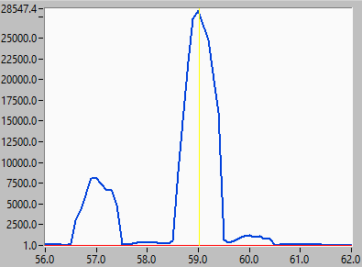
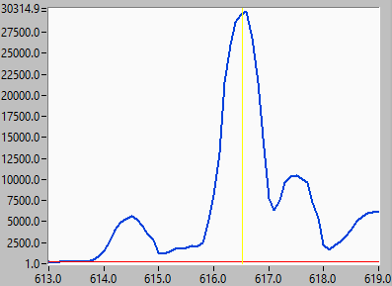
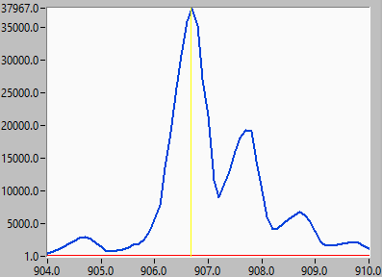
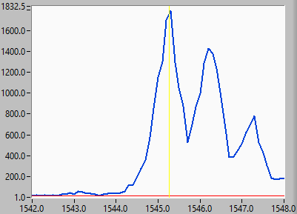
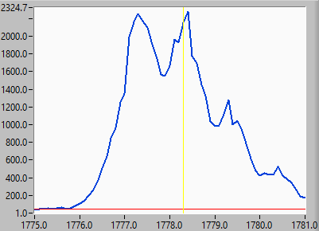
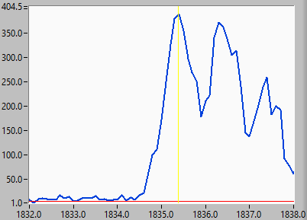
Result from The New Algorithm
Ref Mass (amu) | Mass Found (amu) | Mass Shift (amu) | Peak Width (FWHM) | Peak Height | Base Line
59.05 | 59.02 | -0.03 | 0.7142 | 28278 | 4
616.46 | 616.52 | 0.06 | 0.6765 | 29747 | 206
906.67 | 906.68 | 0.01 | 0.6996 | 37804 | 163
1545.13 | 1545.27 | 0.14 | 0.5844 | 1778 | 13
1778.30 | 1778.30 | 0.00 | 1.0030 | 2233 | 49
1835.20 | 1835.38 | 0.18 | 0.7686 | 385 | 4
( The yellow line indicate the found peak location and the red line indicate the base line)

Slide 5
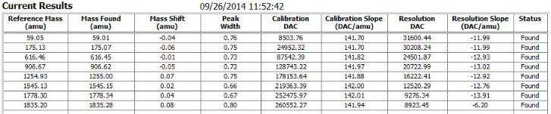
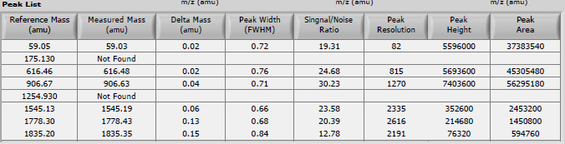
Result from AutoCal
Result from Ion Sniffer

